Slide 1
Chapter 17
Formulation and Planning for
Web Engineering
Software Engineering: A Practitioner’s Approach, 6th edition
by Roger S. Pressman

Slide 2
Formulation
begins with the identification of business need
moves into a description of WebApp objectives
defines major features and functions
establishes a requirements gathering activity that will lead to the development of an analysis model
allows stakeholders and the web engineering team to establish a common set of goals and objectives for the construction of the WebApp.
  identifies the scope of the development effort
  provides a means for determining a successful, outcome..

Slide 3
Formulation Questions
What is the main motivation (business need) for the WebApp?
What are the objectives that the WebApp must fulfill?
Who will use the WebApp?
Answers provide …
Informational goals—indicate an intention to provide specific content and/or information for the end-user
Applicative goals—indicate the ability to perform some task within the WebApp

Slide 4
WebE Requirements Gathering
Ask stakeholders to define user categories and develop descriptions for each category
Communicate with stakeholders to define basic WebApp requirements
Analyze information gathered and use information to follow-up with stakeholders
Define use-cases (Chapter 8) that describe interaction scenarios for each user class

Slide 5
Defining User Categories
What is the user’s overall objective when using the WebApp?
What is the user’s background and sophistication relative to the content and functionality of the WebApp?
How will the use arrive at the WebApp?
What generic WebApp characteristics does the user like/dislike?

Slide 6
Communicating with Stakeholders
Traditional focus groups—a trained moderator meets with a small group of representative end-users (or internal stakeholders playing the role of end-users).
Electronic focus groups—a moderated electronic discussion conducted with a group of representative end-users and stakeholders.
Iterative surveys—a series of brief surveys, addressed to representative users and requesting answers to specific questions about the WebApp
Exploratory surveys—a Web-based survey that is tied to one or more WebApps that have users who are similar to the ones that will use the WebApp to be developed.
Scenario-building—selected user are asked to create informal use-cases that describe specific interactions with the WebApp.

Slide 7
Preliminary Analysis
Categorize information gathered by user class and transaction type
Develop lists of …
  content objects
  operations that are applied to content objects within a specific user transaction
  functions (e.g., informational, computational, logical, and help-oriented) that the WebApp provides for end-users
  other non-functional requirements that are noted during the communication activities.

Slide 8
Use-Cases
Provide the detail necessary to create an effective analysis model
Help the developer to understand how users perceive their interaction with the WebApp
Use-cases help to compartmentalize Web engineering work
Use-cases provide important guidance for those who must test the WebApp

Slide 9
The WebE Team
WebE team roles
  Content Developer/Providers
  Web Publisher
  Web Engineer.
  Business domain experts
  Support Specialist
  Administrator (a.k.a. “Web Master”)

Slide 10
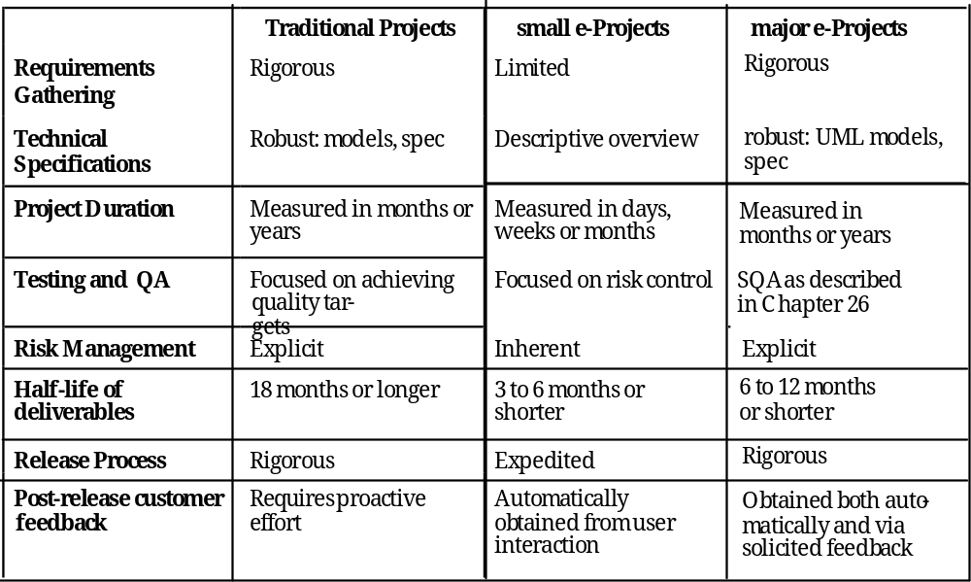
Project Differences

Slide 11
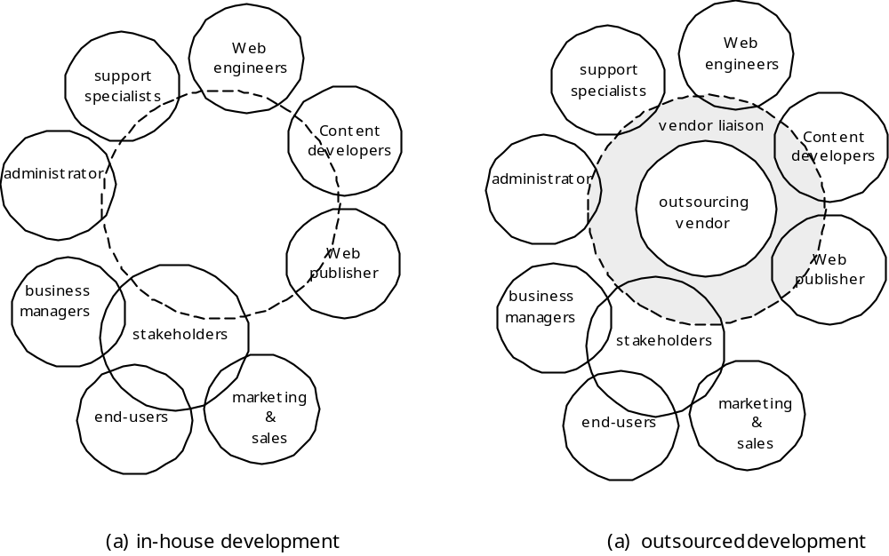
Outsourcing vs. In-house

Slide 12
WebApp Outsourcing - I
Initiate the project by performing the following tasks internally
  Gather requirements
  Develop a “rough design”
  Develop a rough schedule with delivery dates
    Consider increments
  Make a list of responsibilities
    For in-house staff
    For outsourcing vendor
  Define liaison mechanisms

Slide 13
WebApp Outsourcing - II
Select Candidate Outsourcing Vendors
Assess the Validity of Price Quotes and the Reliability of Estimates
  Does the quoted cost of the WebApp provide a direct or indirect return-on-investment that justifies the project?
  Does the vendor that has provided the quote exhibit the professionalism and experience we require?
Understand the Degree of Project Management You Can Expect/Perform
Assess the Development Schedule
Manage Scope

Slide 14
WebApp Planning - In-House
Understand scope, the dimensions of change, and project constraints
Define an incremental project strategy
Perform risk analysis
Develop a quick estimate
Select a task set (process description)
Establish a schedule
Define project tracking mechanisms
Establish a change management approach

Slide 15
WebE “Worst Practices”
We have a great idea, so lets begin building the WebApp—now.
Stuff will change constantly, so there’s no point in trying to understand WebApp requirements.
Developers whose dominant experience has been in traditional software development can develop WebApps immediately. No new training is required.
Be bureaucratic.
Testing? Why bother?

